Slide 1
High Power Efficiency Design Approach of a LLC Resonant Converter for UPS Battery Charger Application and Battery Charge-Discharge Regression Model
ICASEM 2020
Turhan Can KArgın

Slide 2
Presentation Guides
Introduction
LLC Rezonant Converter
Circuit Design
Simulation Results
Regression Models with Machine Learning
Conclusion

Slide 3
Introduction
This presentation present the analysis and design considerations for a half-bridge LLC resonant DC-DC converter. Using the fundamental approximation, the voltage and current waveforms are analyzed and the gain equations are obtained. Half-bridge LLC resonant converter has 400V input and 48V/3.1A output.The circuit is simulated using PSIM software. In addition, it is presented as secondary output to find the charge-discharge models under varying conditions by deriving the regression models with machine learning algorithms where the battery electricity energy consumption, battery status and temperature data can be analyzed.

Slide 4
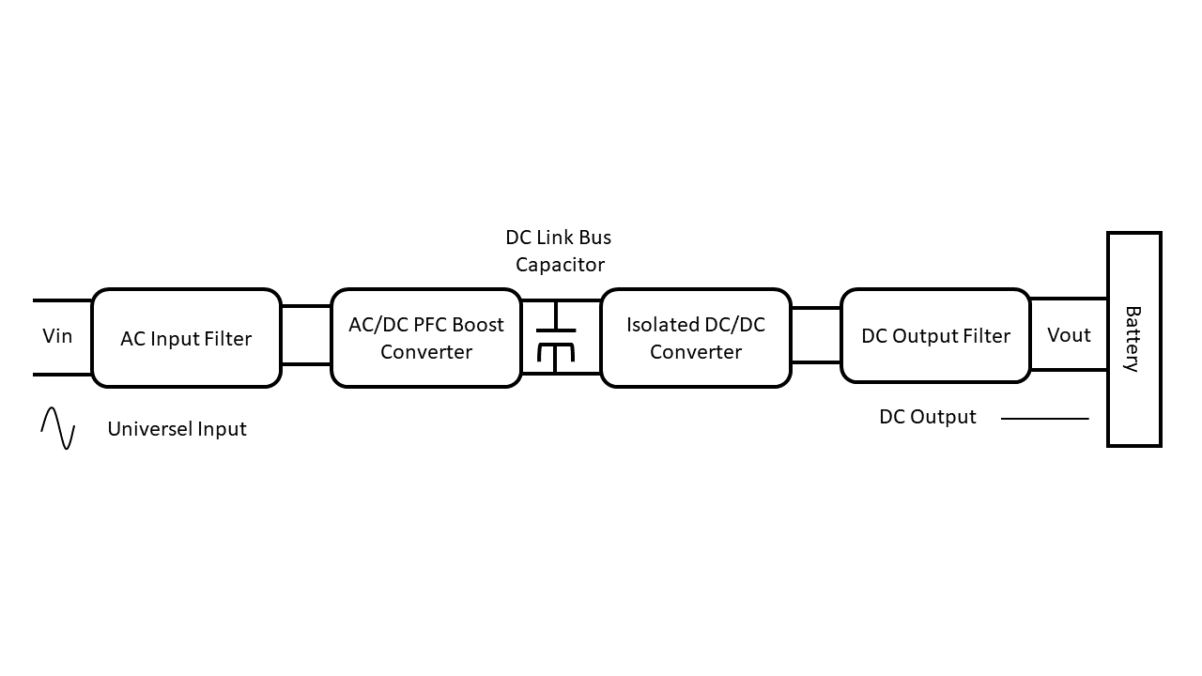
LLC Rezonant Converter
1. Hard Switching and Soft Switching?
2. The advantages of LLC Rezonant Converter
3. Why to use as UPS Battery Charger
Block diagram of a universal battery charger

Slide 5
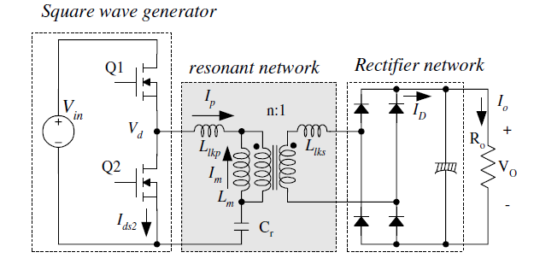

Circuit Design
Define the system specifications and determine the maximum and minimum voltage gains of the resonant network
$P_{in}=\frac{P_{out}}{E_{ff}}$
$V_{in}^{max}=V_{o.PFC}$
$V_{in}^{max}=\sqrt{V_{O.PFC}^{2}−\frac{2P_{in}T_{HU}}{C_{DL}}}$
$M^{min}=\sqrt{\frac{m}{m−1}}$
$M^{max}= \frac{V_{in}^{max}}{V_{in}^{min}}M^{min}$
A schematic of half-bridge LLC resonant converter

Slide 6
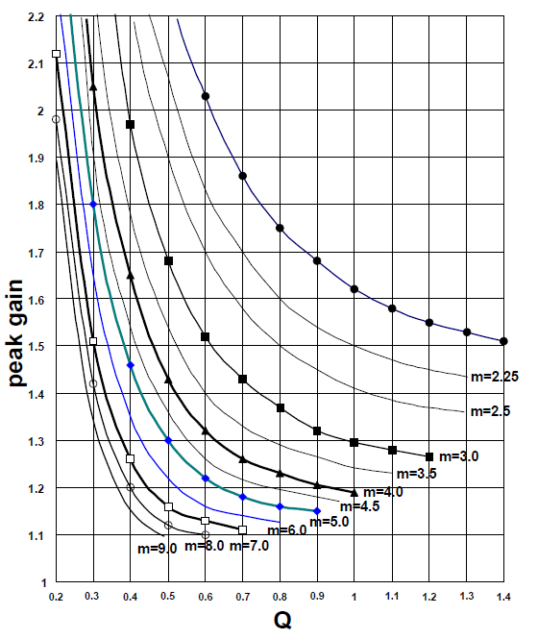

Circuit Design
Calculate the Equivalent Load Resistance and Design the resonant network
$R_{ac}= \frac{8n^{2}}{π^{2}}\frac{V_{0}^{2}}{P_{0}}$
$C_{r}=\frac{1}{2πQ.f_{o}.R_{ac}}$
$L_{r}=\frac{1}{4π^{2}f_{o}^{2}C_{r}}$
$L_{p}=m.L_{r}$
With m value chosen in previous slide, read proper Q value from the peak gain curves in Figure that allows enough peak gain. Considering the load transient and stable zero-voltages-witching (ZVS) operation, 10~20% margin should be introduced on the maximum gain when determining the peak gain.
Peak Gain (Attainable Maximum Gain) vs. Q for Different m Values

Slide 7
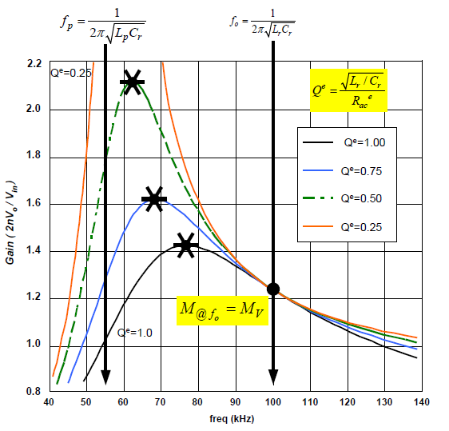

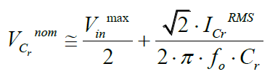


Circuit Design
Design the transformer and select the resonant capacitor
$$N_{p}^{ min}=\frac{n(V_{o}+V_{F})}{2f_{s}^{min}∆B.1,12.A_{e}}$$
From the gain curve of Figure, the minimum switching frequency will be obtained
Typical Gain Curves of LLC Resonant Converter

Slide 8
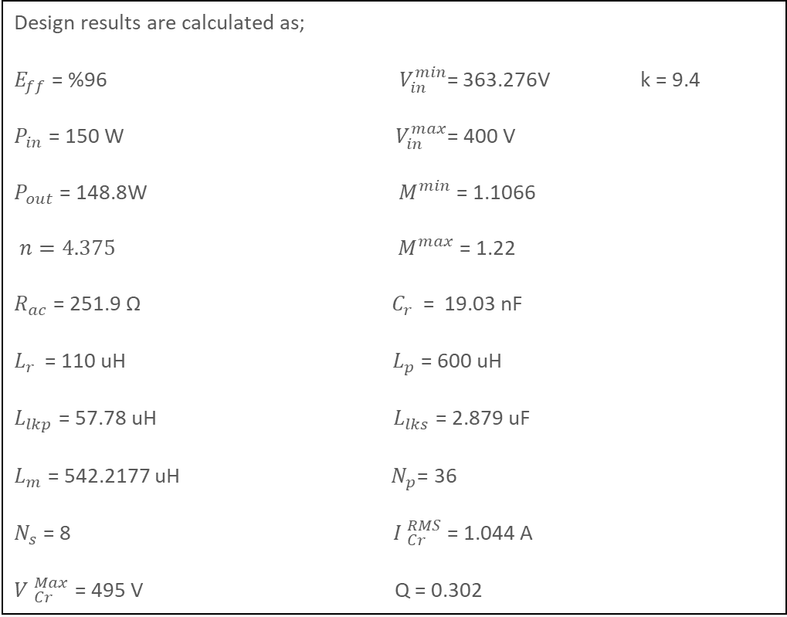
Design Specification
Design results are calculated as;
$E_{ff}$ = %96$V_{in}^{min}$= 363.276V k = 9.4
$P_{in}$ = 150 W ${ V}_{in}^{max}$= 400 V
$P_{out}$ = 148.8W${ M}^{min}$ = 1.1066
$n=4.375 { M}^{max}$ = 1.22
$R_{ac}$ = 251.9 Ω ${ C}_{r }$ = 19.03 nF
$L_{r }$ = 110 uH${ L}_{p}$ = 600 uH
$L_{lkp}$ = 57.78 uH${ L}_{lks}$ = 2.879 uF
$L_{m}$ = 542.2177 uH${ N}_{p}$= 36
$N_{s}$ = 8${ I }_{Cr}^{RMS}$ = 1.044 A
${V }_{Cr}^{Max}$ = 495 V Q = 0.302
Define Ratio ‘n’
Define Value of Mmax-Mmin
Select Value of k and Q
Check M, k and Q Graph
Are the values of M, k and Q is in the Limit.(ZVS)
NO
YES
Calculate ‘Rac’
Therotical calculation results
Calculate ‘Cr’
Circuit design results

Slide 9
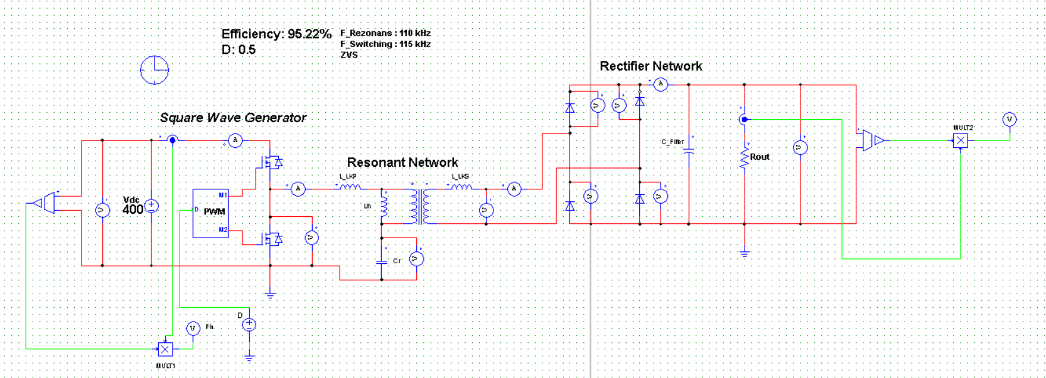
Simulation Results

Slide 10
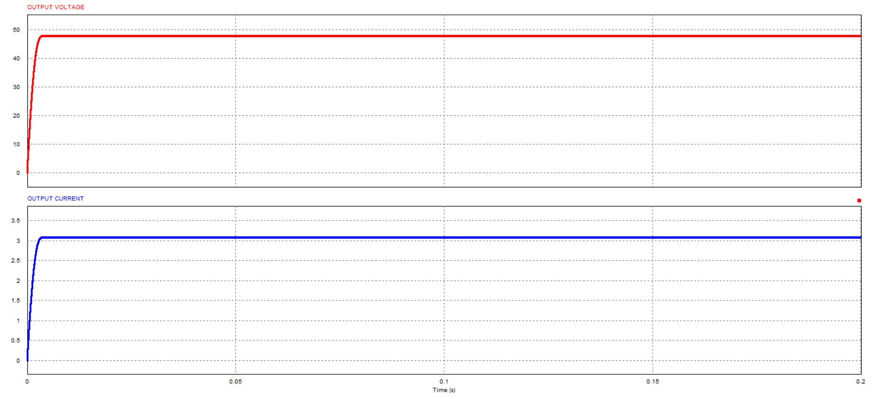
Simulation Results
Output Voltage (V) and output current (A) of the LLC Resonant Converter

Slide 11
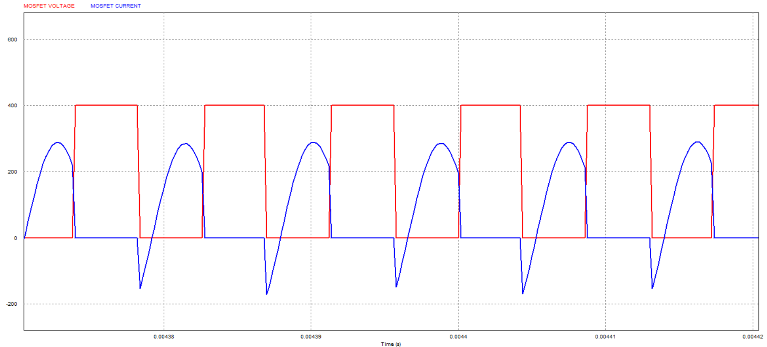

$E_{ff}$ = %9$5.22$
MOSFET voltage (V) and current (A) achieving soft switching

Slide 12
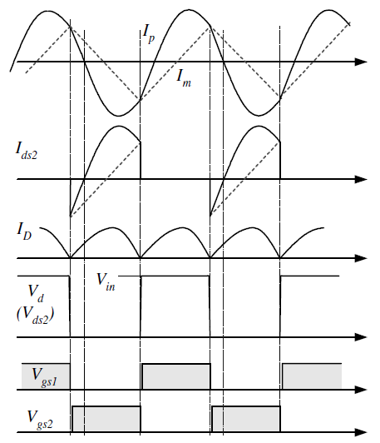
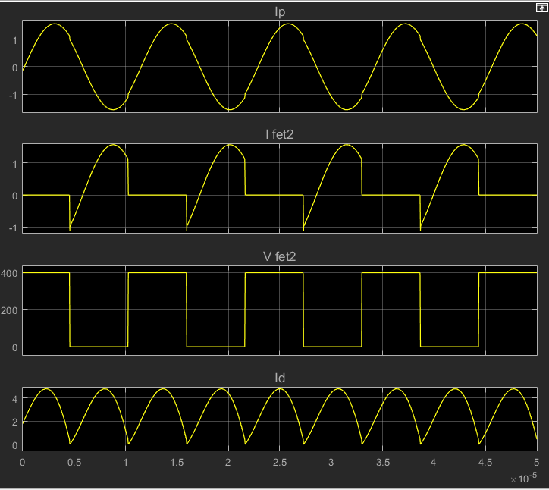
Typical Voltage (V) and current (A) waveforms of half-bridge LLC resonant converter
Simulation Voltage (V) and current (A) waveforms of resonant converter

Slide 13
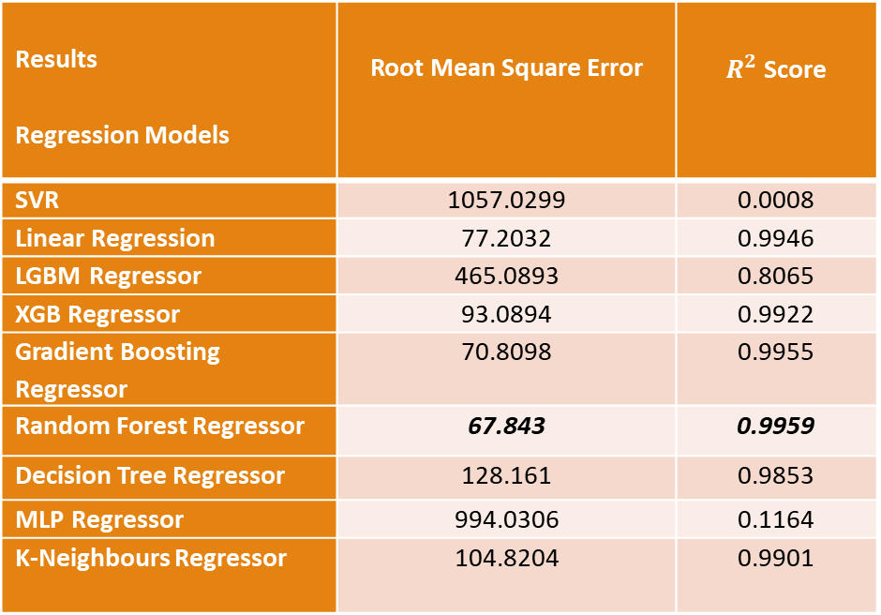
Regression Models with Machine Learning
Results Regression Models | Root Mean Square Error | $R^{2}$ Score
SVR | 1057.0299 | 0.0008
Linear Regression | 77.2032 | 0.9946
LGBM Regressor | 465.0893 | 0.8065
XGB Regressor | 93.0894 | 0.9922
Gradient Boosting Regressor | 70.8098 | 0.9955
Random Forest Regressor | 67.843 | 0.9959
Decision Tree Regressor | 128.161 | 0.9853
MLP Regressor | 994.0306 | 0.1164
K-Neighbours Regressor | 104.8204 | 0.9901
Regression model comparison using Python

Slide 14
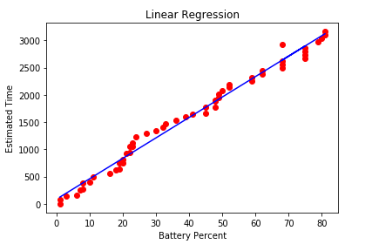
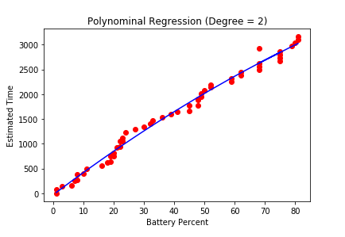
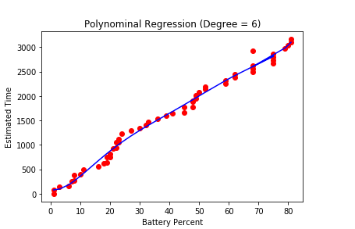
Regression Models with Machine Learning
Visualization of battery discharge regression models

Slide 15
Conclusion
Designing circuit by using PCB design program (Eagle), production and testing of the circuit. Also,comparison with practical, theoretical and simulation results will be done soon.
Creating a database with the obtained data and creating a battery charge-discharge regression model were done.
Simulation of the system with the simulation program (PSIM) and comparison with the theoretical results were done.
Circuit analysing and therotical calculations were made.

Slide 16

Thank You

